Slide 1
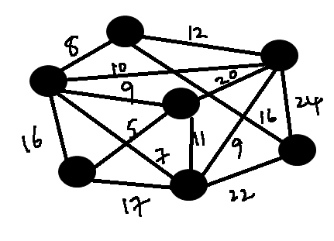
Spanning Trees
Data Structures Week 9
We will now consider another famous problem in graphs.
Imagine providing connectivity to a set of cities.
Each highway connects two cities
In reality, each highway requires a certain cost to be built.

Slide 2
Spanning Trees
Data Structures Week 9
So, there is a trade-off here.
How to provide connectivity while minimizing the total cost of building the highways.
The weights on the edges indicate the cost of building that highway.
The total cost of connectivity = sum of all the built up highway.
Minimize this cost.

Slide 3
Spanning Trees
Data Structures Week 9
Formalize the problem as follows.
Let G = (V, E, W) be a weighted graph.
Find a subgraph G' of G that is connected and has the smallest cost
  Cost is defined as the sum of the edge weights of edges in G'.

Slide 4
Spanning Trees
Data Structures Week 9
Observation I : If G' has a cycle and is connected, then there exists a G'', which is also a subgraph of G and is connected so that
cost(G'') < cost(G')‏
To get G'', simply break at least one cycle of G'.
Hence, the optimal G' shall have no cycles and is connected.
  Suggests that G' is a tree.

Slide 5
Spanning Trees
Data Structures Week 9
Two keywords : spanning and tree.
Some notation: A subgraph G' of G is called a spanning subgraph if V(G') = V(G).
A spanning subgraph G' of G that is also a tree is called as a spanning tree of G.

Slide 6
Spanning Trees
Data Structures Week 9
So, our problem can be reduced to “Find a spanning tree of G that has the least cost.”
Such a spanning tree is also called as a minimum cost spanning tree of G. Often one refers to this as the minimum spanning tree.

Slide 7
MST
Data Structures Week 9
Let us now think of devising an algorithm to construct an MST of a given weighted graph G.
There are several approaches, but let us consider a bottom-up approach.
Let us start with a graph (tree) that has no edges and add edges successively.
Every new edge we add should not create a cycle.
Further, the total cost of the final tree should be the least possible.

Slide 8
MST
Data Structures Week 9
Suggests that we should prefer edges of smaller weight.
  But should not add edges that create cycles.
Indeed, that is intuitive and turns out that is correct too.
  we will skip the proof of this.

Slide 9
MST Algorithm
Data Structures Week 9
Algorithm MST(G)‏
begin
  sort the edges of G in increasing order of weight as e₁, e₂, ..., e_{m}
  k = 1; V(T) = V(G); E(T) = Φ
  while |E(T)| < n-1 do
      if E(T) U e_{k} does not have a cycle then
        E(T) = E(T) U e_{k}
      end-if
      k = k + 1;
  end-while
End.

Slide 10
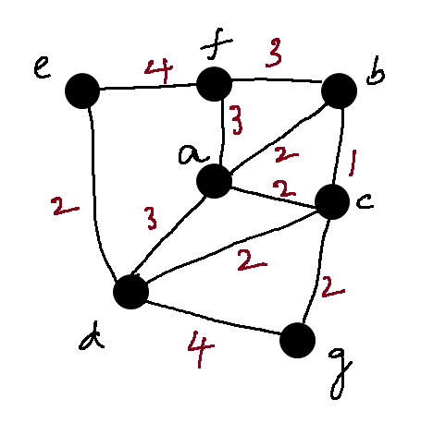
MST Practice Problem
Data Structures Week 9
Algorithm MST(G)‏
begin
  sort the edges of G in increasing order of weight as e₁, e₂, ..., e_{m}
  k = 1; V(T) = V(G); E(T) = Φ
  while |E(T)| < n-1 do
      if E(T) U e_{k} does not have a cycle then
        E(T) = E(T) U e_{k}
      end-if
      k = k + 1;
  end-while
End.

Slide 11
l
Data Structures Week 9
MST Example
List of edges by weight
  bc, ab, ac, cg, cd, de, bf, af, ad, ef, dg

Slide 12
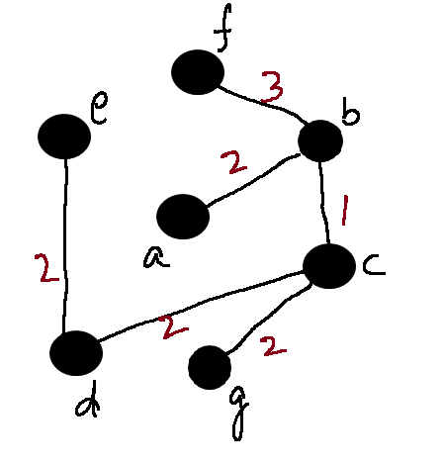
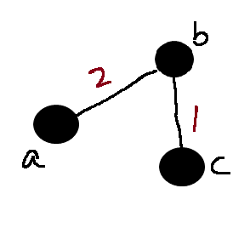
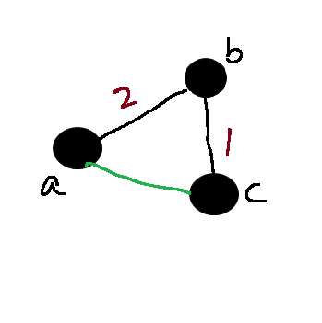
l
Data Structures Week 9
MST Example
List of edges by weight
  bc, ab, ac, cg, cd, de, bf, af, ad, ef, dg

Slide 13
MST Algorithm Analysis
Data Structures Week 9
The algorithm we devised is called the Kruskal's algorithm.
Belongs to a class of algorithms called greedy algorithms.
How do we analyze our algorithm?
  Need to know how to implement the cycle checker.

Slide 14
MST Algorithm Analysis
Data Structures Week 9
How quickly can we find if a given graph has a cycle?
  O(m+n) is possible using DFS.
Notice that if the graph is a forest, then m = O(n).
So, can be done in O(n) time.
Also, need to try all m edges in the worst case.
So the time required in this case is O(mn).

Slide 15
MST Algorithm Analysis
Data Structures Week 9
Too high in general.
But, advanced data structures exist to bring the time down very close to O(m+n).
  Cannot be covered in this class.
  We will show an approach that takes us almost there.

Slide 16
MST – Another Approach
Data Structures Week 9
The previous approach has to check for cycles every iteration.
Another approach that has a smaller runtime even with basic data structures.
Largely simplifies the solution.

Slide 17
MST – Another Approach
Data Structures Week 9
The previous approach is characterized by having a single tree T at any time.
In each iteration, T is extended by adding one vertex v not in T and one edge from v to some vertex in T.
Starting from a tree of one node, this process is repeated n-1 times.

Slide 18
MST – Another Approach
Data Structures Week 9
Two questions:
  How to pick the new vertex v?
  How to pick the edge to be added from v to some other vertex in T?

Slide 19
MST – Another Approach
Data Structures Week 9
The answers are provided by the following claims.
Claim 1: Let G = (V, E, W) be a weighted undirected graph. Let v be any vertex in G. Let vw be the edge of smallest weight amongst all edges with one endpoint as v. Then vw is always contained in any MST of G.

Slide 20
MST – Another Approach
Data Structures Week 9
Claim 1 can be shown in the following way.
For each vertex v in G, there must be at least one edge in any MST.
Considering the edge of the smallest weight is useful as it can decrease the cost of the spanning tree.

Slide 21
Generalizing Claim 1.
Data Structures Week 9
Claim 2 can be generalized further.
Let T be a subtree of some MST of an undirected weighted graph G. Consider edges uv in G such that u is in T and v is not in T. Of all such edges, let e = xy be the edge with the smallest weight. Then T U {e} is also a subtree of some MST of G.

Slide 22
Generalizing Claim 1.
Data Structures Week 9
Claim 2 allows us to expand a given sub-MST T.
We can use Claim 2 to expand the current tree T.
How to start?

Slide 23
Towards an Algorithm
Data Structures Week 9
Let v be any vertex in the graph G. Pick v as the starting vertex to be added to T.
T now contains one vertex and no edges.
T is a subtree of some MST of G.
Now, apply Claim 2 and extend T.

Slide 24
Towards an Algorithm
Data Structures Week 9
Algorithm MST(G, v)
Begin
Add v to T;
While T has less than n – 1 edges do
w = vertex s.t. vw has the smallest weight
amongst edges with one endpoint in T and another not in T.
Add vw to T.
End
End

Slide 25
Towards an Algorithm
Data Structures Week 9
How to find w in the algorithm?
Need to maintain the weight of edges that satisfy the criteria.
A better approach:
  Associate a key to every vertex
  key[v] is the smallest weight of edges with v as one endpoint and another in the current tree T.
  key[v] changes only when some vertex is added to T.
  Vertex with the smallest key[v] is the one to be added to T.

Slide 26
Towards an Algorithm
Data Structures Week 9
Suggests that key[v] need to be updated only when a new vertex is added to T.
Further, not all key[v] may change in every iteration.
  Only the neighbors of the vertex added to T.
  Similar to Dijkstra's algorithm.

Slide 27
Towards an Algorithm
Data Structures Week 9
Therefore, can maintain a heap of vertices with their key[ ] values.
Initially, key[v] = infinity for every vertex except the start vertex for which key value can be 0.
Perform DeleteMin on the heap. Let v be the result.
Update the key[ ] value for neighbors w of v as:
  key[w] = min{key[w], W(vw)}

Slide 28
Algorithm Using a Heap
Data Structures Week 9
Algorithm MST(G, u)
begin
for each vertex v do key[v] = infty.
key[u] = 0;
Add all vertices to a heap H.
While T has less than n-1 edges do
v = deleteMin();
Add v to T via uv s.t. u is in T
For each neighbor w of v do
if W(vw) > key[w] then DecreaseKey(w)
end
end
end

Slide 29
Algorithm Using a Heap
Data Structures Week 9
The algorithm is called as Prim's algorithm.
Runtime easy to analyze;
  Each vertex deleted once from the heap. Each DeleteMin() takes O(log n) time. So, this accounts for a time of O(nlog n).
  Each edge may result in one call to DecreaseKey(). Over m edges, this accounts for a time of O(mlog n).
  Total time = O((n+m)log n).

